Slide 1
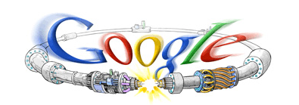
LHC Accelerator Status and Plans
Eric Prebys, Fermilab
Director, US LHC Accelerator Research Program (LARP)
Google welcome screen from September 10, 2008

Slide 2
Outline
Overview of the LHC
2008 Startup and “The Incident”
The Response
Startup and current commissioning status
2009/2010 Run plans
The future (as time permits)
Note: This talk is a monument to plagiarism. I’ll give specific acknowledgements and “further reading” at the end.

Slide 3
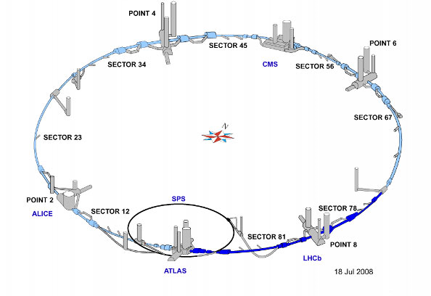
LHC Layout
8 crossing interaction points (IP’s)
Accelerator sectors labeled by which points they go between
ie, sector 3-4 goes from point 3 to point 4

Slide 4
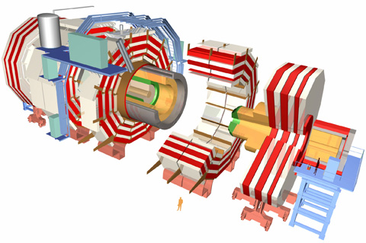
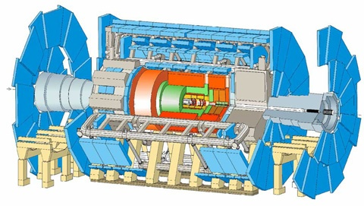
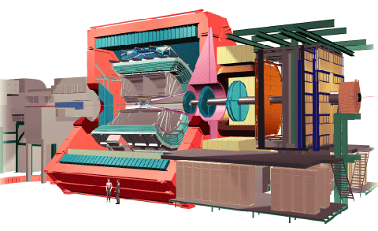
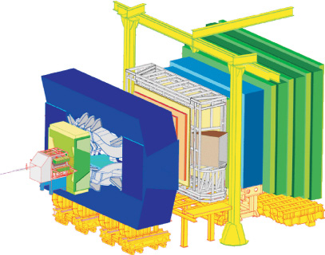
CERN experiments
Huge, general purpose experiments:
“Medium” special purpose experiments:
Compact Muon Solenoid (CMS)
A Toroidal LHC ApparatuS (ATLAS)
A Large Ion Collider Experiment (ALICE)
B physics at the LHC (LHCb)

Slide 5
Nominal LHC parameters compared to Tevatron
Parameter | Tevatron | “nominal” LHC
Circumference | 6.28 km (2*PI) | 27 km
Beam Energy | 980 GeV | 7 TeV
Number of bunches | 36 | 2808
Protons/bunch | 275x10⁹ | 115x10⁹
pBar/bunch | 80x10⁹ | -
Stored beam energy | 1.6 + .5 MJ | 366+366 MJ*
Peak luminosity | 3.3x10³² cm⁻²s⁻¹ | 1.0x10³⁴ cm⁻²s⁻¹
Main Dipoles | 780 | 1232
Bend Field | 4.2 T | 8.3 T
Main Quadrupoles | ~200 | ~600
Operating temperature | 4.2 K (liquid He) | 1.9K (superfluid He)
1.0x10³⁴ cm⁻²s⁻¹ ~ 50-100 fb⁻¹/yr
*2.1 MJ ≡ “stick of dynamite” ⇒ very scary numbers

Slide 6
LHC (partial) timeline
1994:
The CERN Council formally approves the LHC
1995:
LHC Technical Design Report complete
2000:
LEP completes its final run
2002:
Magnet production fully transferred to industry
2005
Civil engineering complete (CMS cavern)
First dipole lowered into tunnel
2007
Last magnet delivered
All interconnections completed
2008
Accelerator complete
Last public access
Ring cold and under vacuum

Slide 7
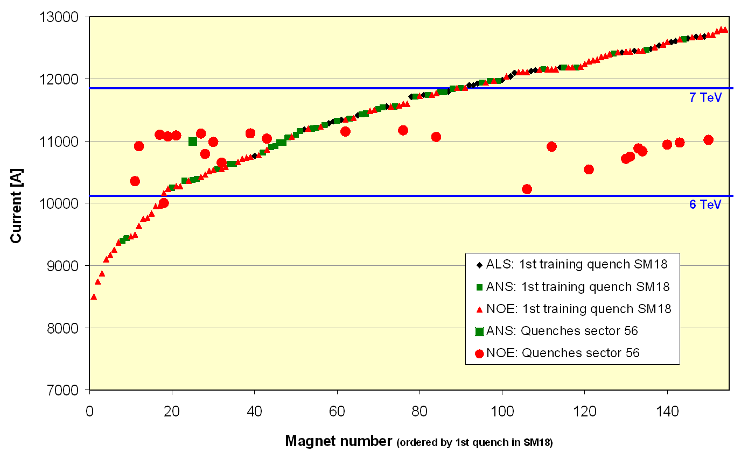
Problems Discovered Prior to 2008 Start
1st Training quench above ground
Magnet de-training
ALL magnets were trained to achieve 7+ TeV after a thermal cycle.
After being installed in the tunnel, it was discovered that the magnets supplied by one of the three vendors “forgot” their training, and would need to be retrained to reach 7 TeV.
Symmetric Quenches
The original LHC quench protection system subtracted the inductive voltage drop by taking the difference between the voltage drop across the two apertures.
It was discovered in tests that when quenches propagate from one dipole to the next, they often do so symmetrically, rendering the system dangerously insensitive at high current.
1st quench in tunnel
For these reasons, the initial energy target was reduced to 5+5 TeV well before the start of the 2008 run.

Slide 8
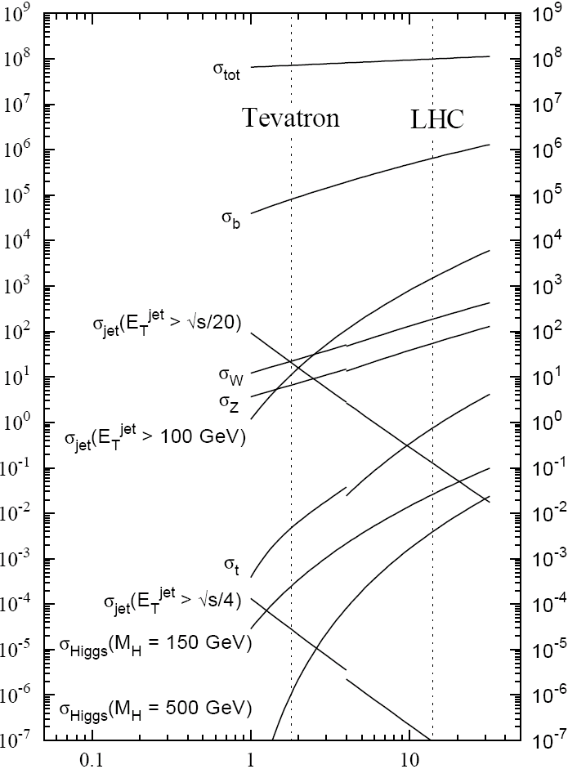
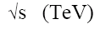
Experimental reach of LHC vs. Tevatron
200 pb⁻¹ at 5 TeV+5 TeV
~5 fb⁻¹ at 1 TeV+ 1 TeV
σ_{W} (M_{W}=80 GeV)
σ_{Z} (M_{Z}=91 GeV)
Only HEP slide in this talk

Slide 9
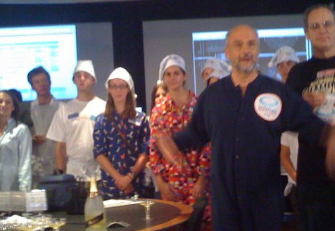
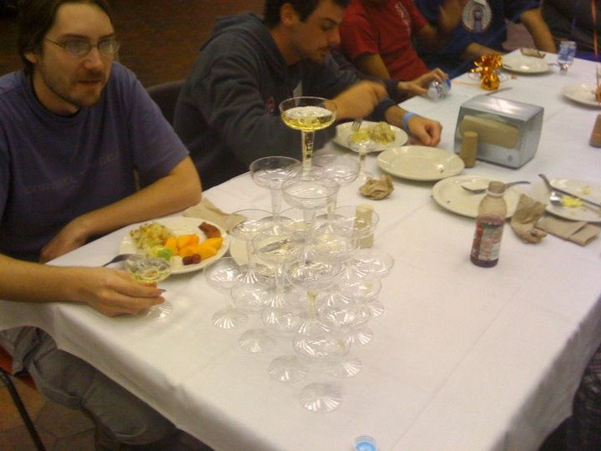
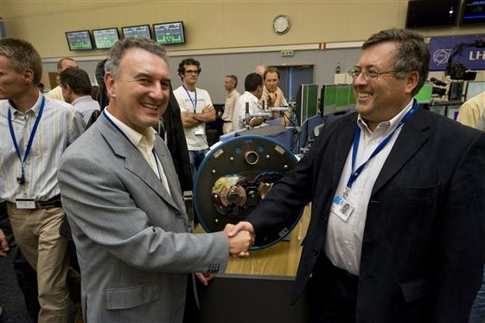
Sept 10, 2008: The (first) big day
9:35 – First beam injected
9:58 – beam past CMS to point 6 dump
10:15 – beam to point 1 (ATLAS)
10:26 – First turn!
…and there was much rejoicing
Commissioning proceeded smoothly and rapidly until September 19th, when something very bad happened

Slide 10

Nature abhors a (news) vacuum…
Italian newspapers were very poetic (at least as translated by “Babel Fish”):
"the black cloud of the bitterness still has not been dissolved on the small forest in which they are dipped the candid buildings of the CERN"
“Lyn Evans, head of the plan, support that it was better to wait for before igniting the machine and making the verifications of the parts.“*
Or you could Google “What really happened at CERN”:
**
* “Big Bang, il test bloccato fino all primavera 2009”, Corriere dela Sera, Sept. 24, 2008
**http://www.rense.com/general83/IncidentatCERN.pdf

Slide 11
What (really) really happened on September 19^{th*}
Sector 3-4 was being ramped to 9.3 kA, the equivalent of 5.5 TeV
All other sectors had already been ramped to this level
Sector 3-4 had previously only been ramped to 7 kA (4.1 TeV)
At 11:18AM, a quench developed in the splice between dipole C24 and quadrupole Q24
Not initially detected by quench protection circuit
Power supply tripped at .46 sec
Discharge switches activated at .86 sec
Within the first second, an arc formed at the site of the quench
The heat of the arc caused Helium to boil.
The pressure rose beyond .13 MPa and ruptured into the insulation vacuum.
Vacuum also degraded in the beam pipe
The pressure at the vacuum barrier reached ~10 bar (design value 1.5 bar). The force was transferred to the magnet stands, which broke.
*Official talk by Philippe LeBrun, Chamonix, Jan. 2009

Slide 12
Pressure forces on SSS vacuum barrier
Vacuum
Pressure
1 bar
1/3 load on cold mass (and support post)
~23 kN
1/3 load on barrier
~46 kN
Total load on 1 jack ~70 kN
V. Parma

Slide 13
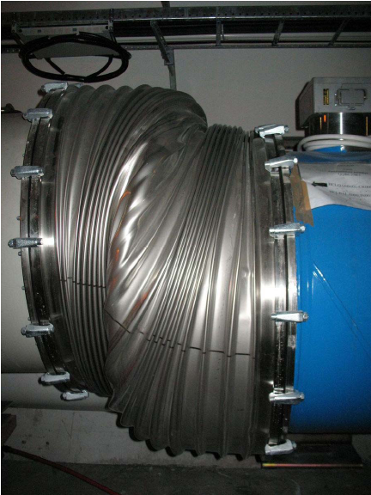
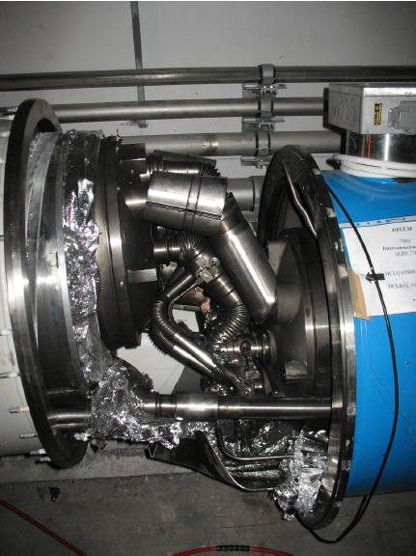
Collateral damage: magnet displacements
QQBI.27R3

Slide 14
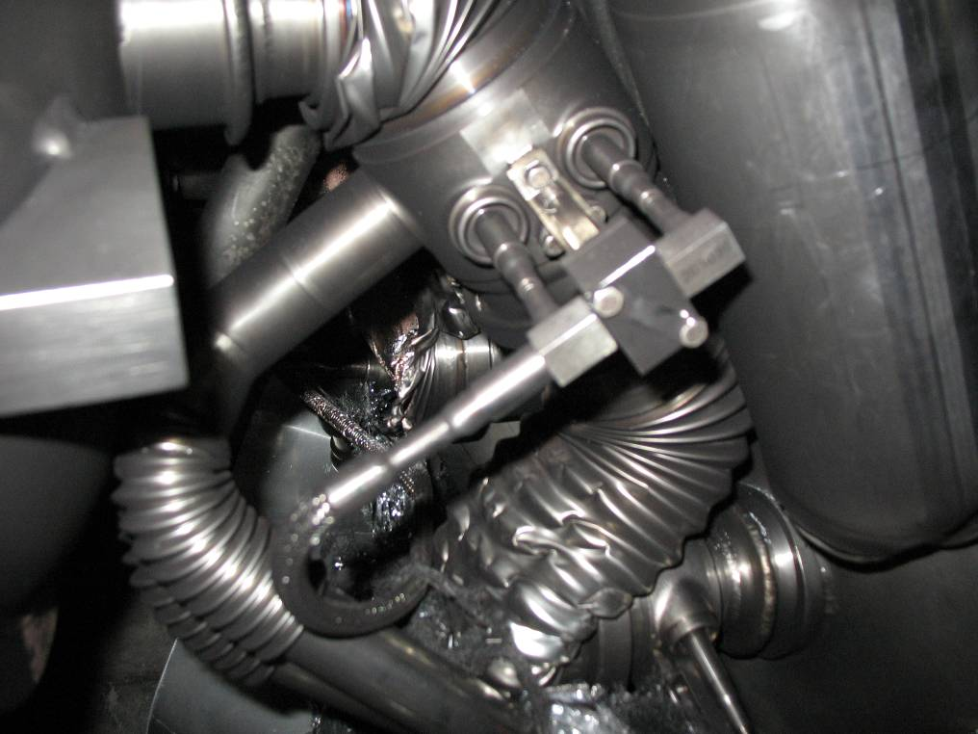
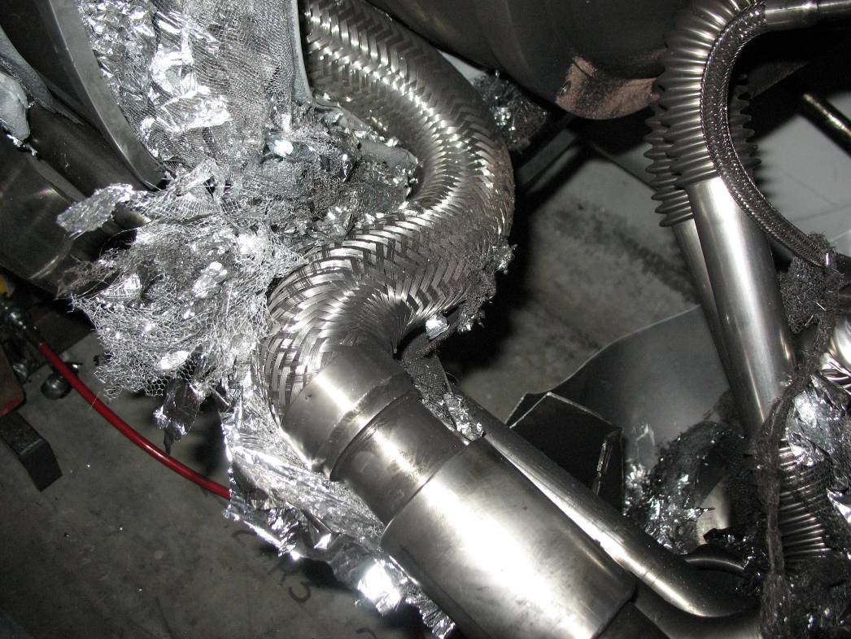
Collateral damage: magnet displacements
QQBI.27R3
N line
QQBI.27R3
V2 line

Slide 15
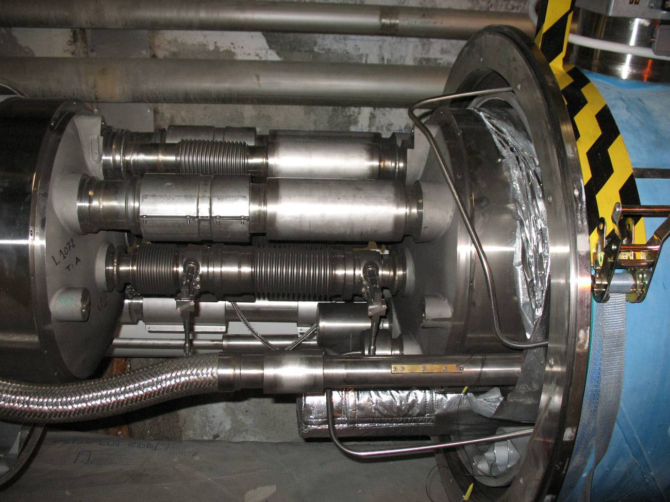
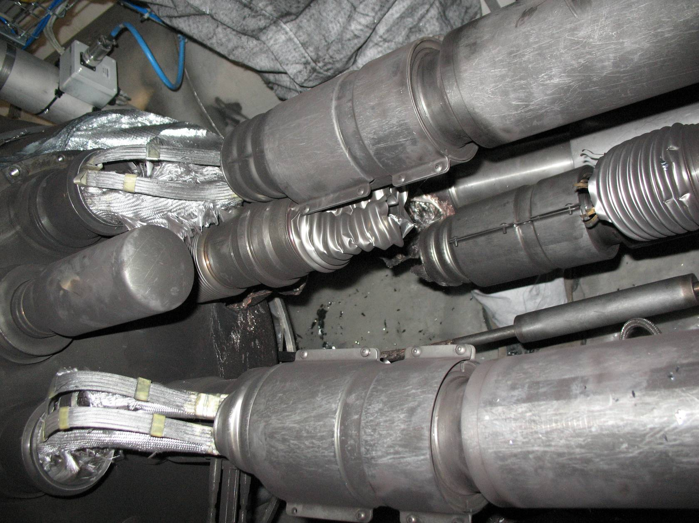
Collateral damage: magnet displacements
QBQI.27R3
Bellows torn open
QBBI.B31R3
Extension by 73 mm

Slide 16
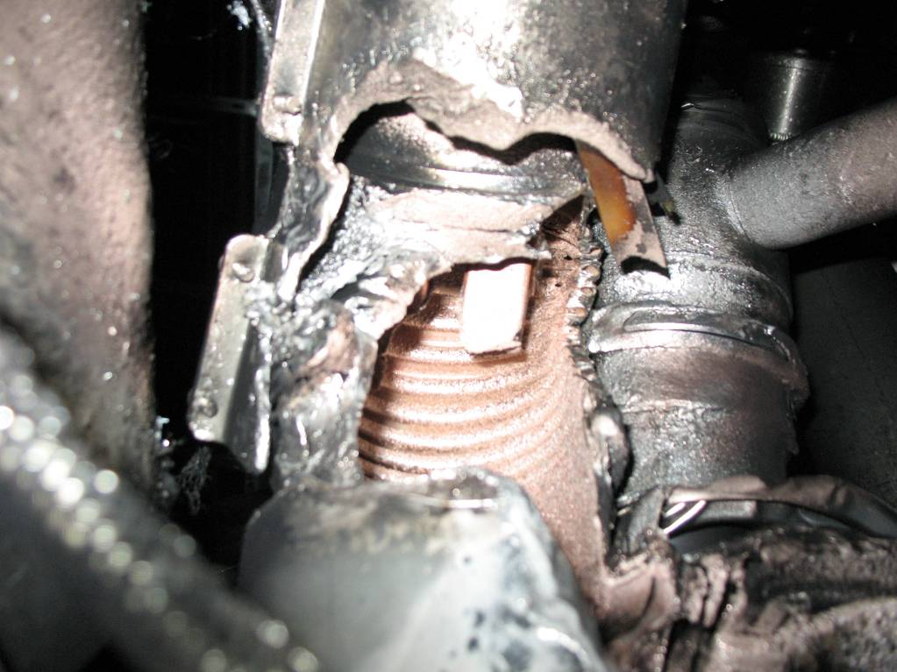
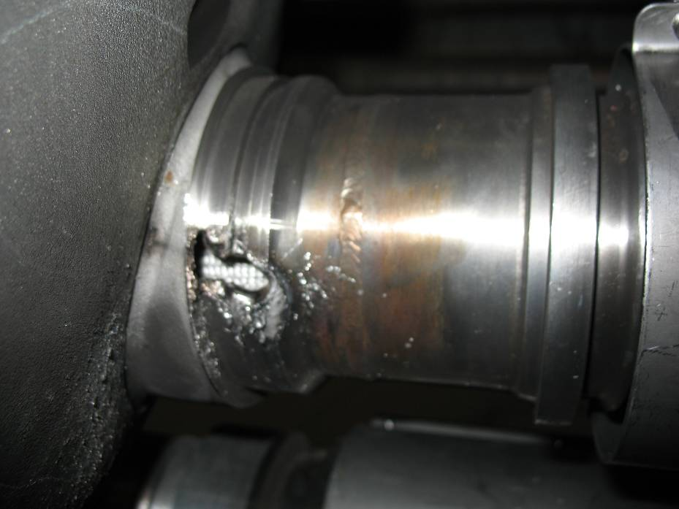
Collateral damage: secondary arcs
QBBI.B31R3 M3 line
QQBI.27R3 M3 line

Slide 17
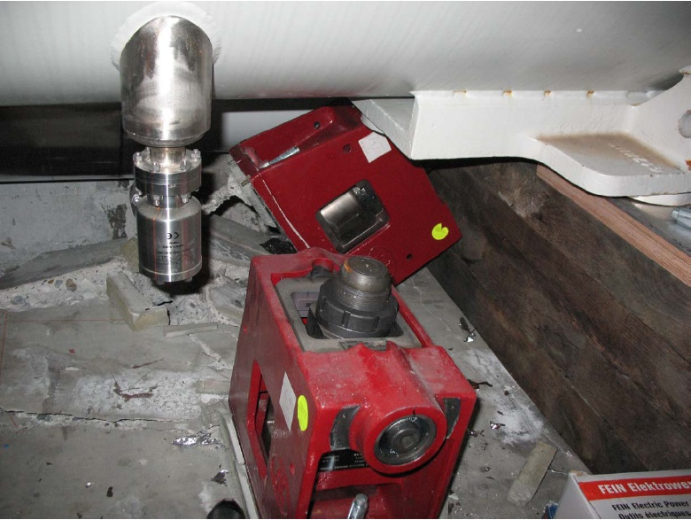
Collateral damage: ground supports

Slide 18
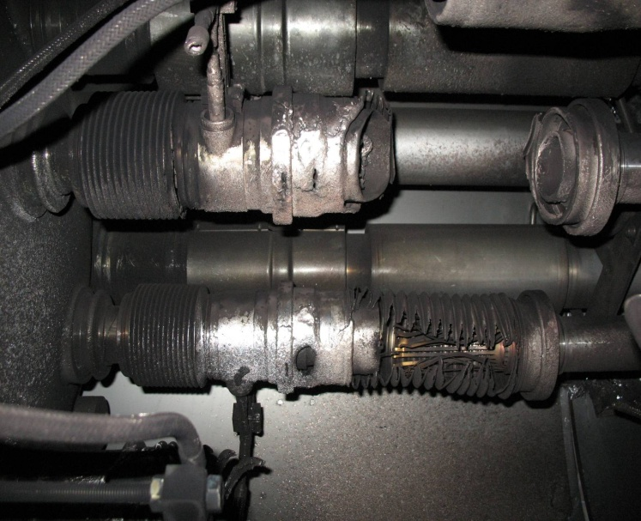
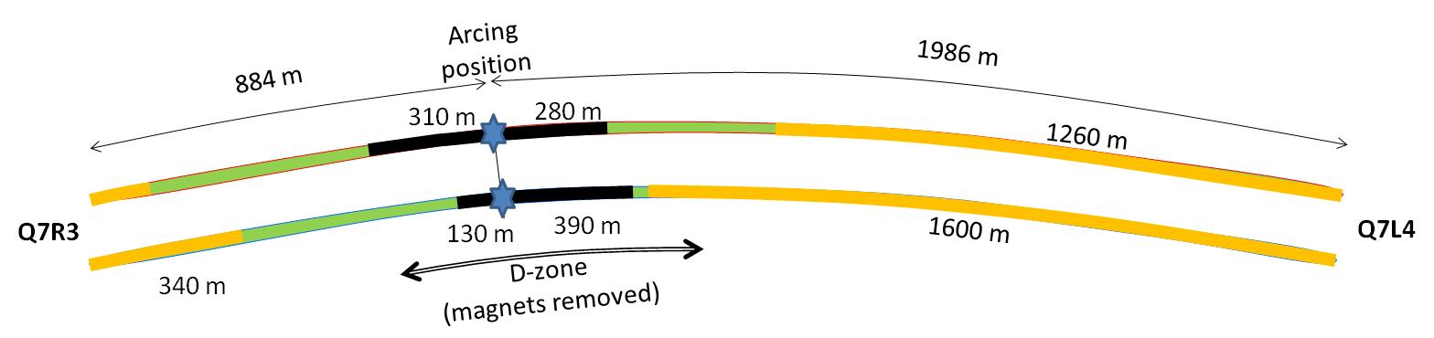

Collateral damage: Beam Vacuum
Arc burned through beam vacuum pipe
clean
MLI
soot
The beam pipes were polluted with thousands of pieces of MLI and soot, from one extremity to the other of the sector
LSS3
LSS4
OK
Debris
MLI
Soot

Slide 19
Replacement of magnets
15 Quadrupoles (MQ)
1 not removed (Q19)
14 removed
8 cold mass revamped (old CM, partial de-cryostating for cleaning and careful inspection of supports and other components)
6 new cold masses
Some additional old cold masses salvageable
42 Dipoles (MBs)
3 not removed (A209,B20,C20)
39 removed
9 Re-used (old cold mass, no decryostating –except one?)
30 new cold masses
New cold masses are much faster to prepare than rescuing doubtful dipoles)
Many old cold masses salvageable.

Slide 20
Important questions about Sept. 19
Why did the joint fail?
Inherent problems with joint design
No clamps
Details of joint design
Solder used
Quality control problems
Why wasn’t it detected in time?
There was indirect (calorimetric) evidence of an ohmic heat loss, but these data were not routinely monitored
The bus quench protection circuit had a threshold of 1V, a factor of >1000 too high to detect the quench in time.
Why did it do so much damage?
The pressure relief system was designed around an MCI Helium release of 2 kg/s, a factor of ten below what occurred.

Slide 21
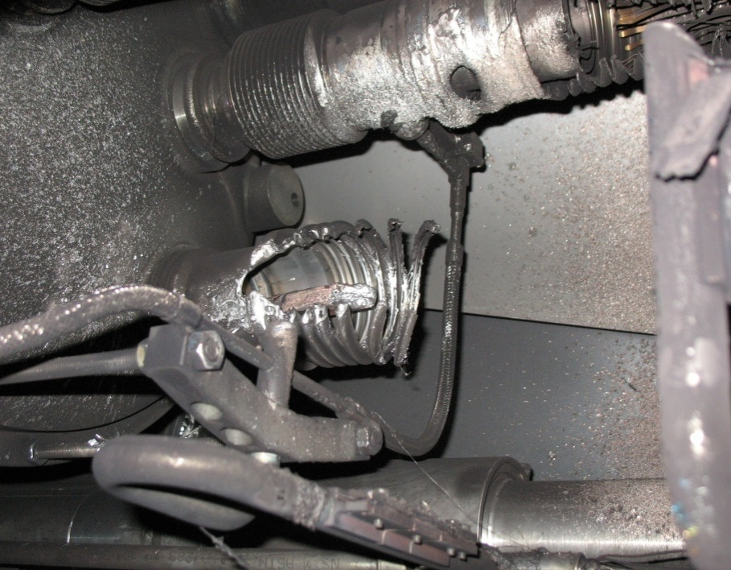
What happened?
Theory: A resistive joint of about 220 nΩ with bad electrical and thermal contacts with the stabilizer
No electrical contact between wedge and U-profile with the bus on at least 1 side of the joint
No bonding at joint with the U-profile and the wedge
Loss of clamping pressure on the joint, and between joint and stabilizer
Degradation of transverse contact between superconducting cable and stabilizer
Interruption of longitudinal electrical continuity in stabilizer
Problem: this is where the evidence used to be
A. Verweij

Slide 22
Improved quench protection*
Old quench protection circuit triggered at 1V on bus.
New QPS triggers at .3 mV
Factor of 3000
Should be sensitive down to 25 nOhms (thermal runaway at 7 TeV)
Can measure resistances to <1 nOhm
Concurrently installing improved quench protection for “symmetric quenches”
A problem found before September 19th
Worrisome at >4 TeV
*See talks by Arjan Verveij and Reiner Denz, Chamonix 2009

Slide 23
Improved pressure relief*
New configuration on four cold sectors: Turn several existing flanges into pressure reliefs (while cold). Also reinforce stands to hold ~3 bar
New configuration on four
warm sectors: new flanges
(12 200mm relief flanges)
(DP: Design Pressure)
L. Tavian
*Vittorio Parma and Ofelia Capatina, Chamonix 2009

Slide 24
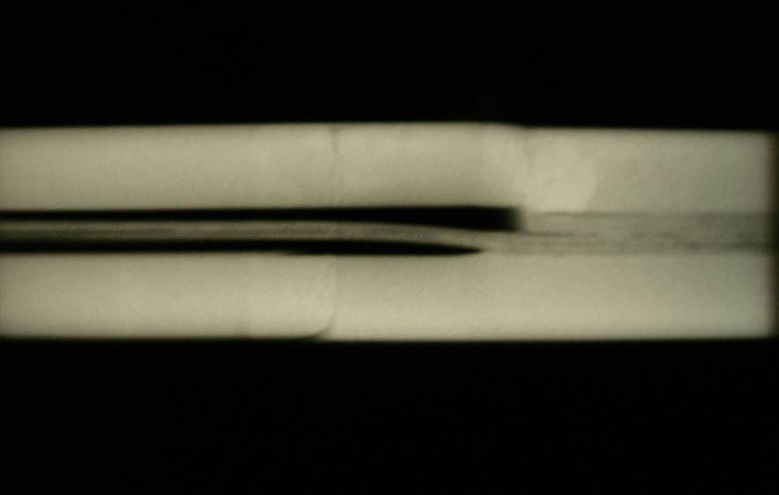
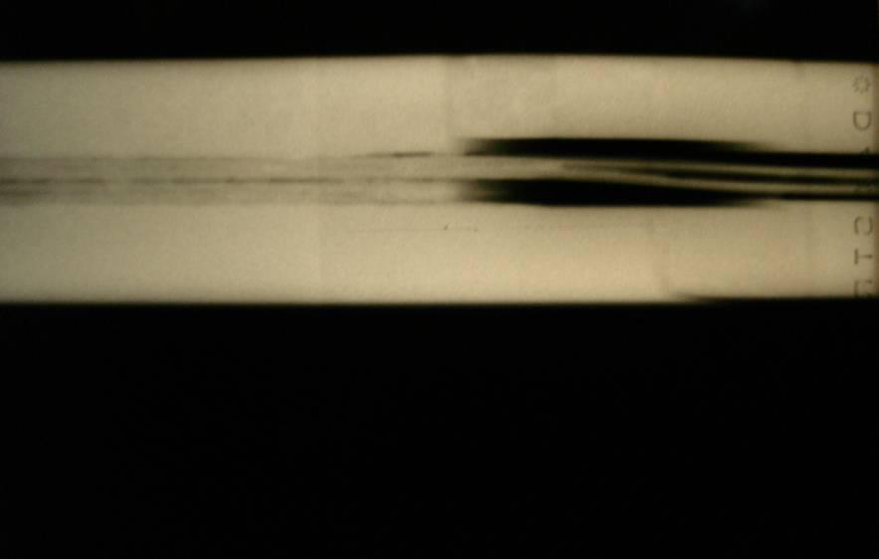
Bad surprise
With new quench protection, it was determined that joints would only fail if they had bad thermal and bad electrical contact, and how likely is that?
Very, unfortunately ⇒ must verify copper joint
Have to warm up to at least 80K to measure Copper integrity.
Solder used to solder joint had the same melting temperature as solder used to pot cable in stablizer
⇒Solder wicked away from cable

Slide 25
Machine wide activities Q4 2008 and 2009
Sector 34 repair
Restart
Q4 2008 | Q1 2009 | Q2 2009 | Q3 2009 | Q4 2009
Electrical splice measurements everywhere while cold (measuring nΩ) Q4 2008
Had to warm up sectors 12 56 67
Electrical stabilizer measurements everywhere while warm or at 80K (measuring µΩ) Q1 Q2 2009
Had to warm up sector 45
Major new protection system based on electrical measurements Q1 – Q4 2009 (nQPS)
Pressure relief valves installed everywhere possible Q1 – Q3 2009 (dipoles have to be warm)
Reinforcement of floor anchors everywhere Q1 – Q3 2009
Q4 2008 |  | Q1 2009 | Q2 2009 | Q3 2009 | Q4 2009
12 | Cold | Cold ➔ Warm | Warm | Warm ➔ Cold | Cold
23 | < 100K | < 100K | < 100K ➔ Cold | Cold ➔ 80K ➔ Cold | Cold
34 | Warm | Warm | Warm | Warm ➔ Cold | Cold
45 | < 100K | < 100K | 80K ➔ Warm | Warm ➔ Cold | Cold
56 | Cold | Cold ➔ Warm | Warm | Warm ➔ Cold | Cold
67 | Cold | Cold ➔ Warm | Warm | Warm ➔ Cold | Cold
78 | Cold | < 100K | < 100K ➔ 80K | 80K ➔ Cold | Cold
81 | Cold | < 100K | < 100K ➔ 80K | 80K ➔ Cold | Cold

Slide 26
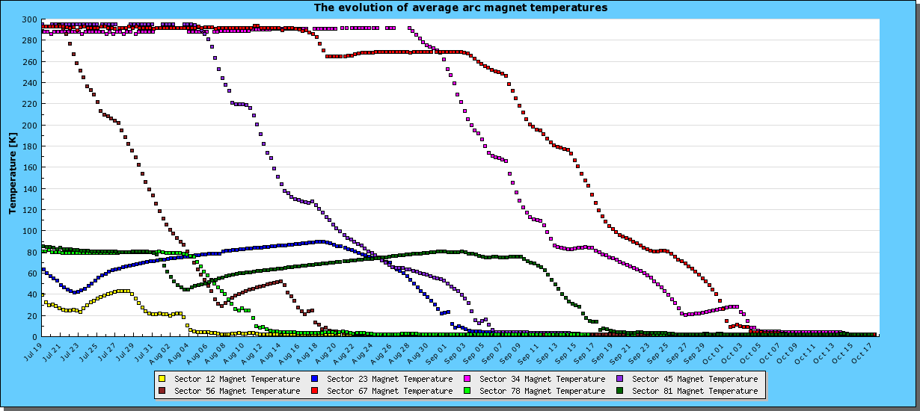
Cool down 2009

Slide 27
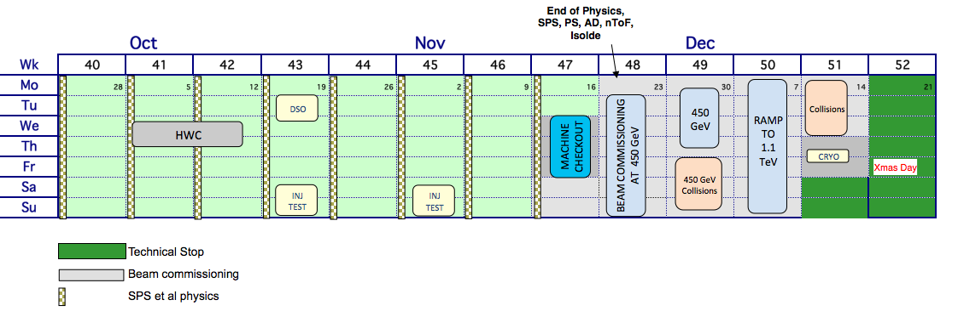
2009 Plans (as of November 1)*
Decision to limit energy to 1.2 TeV based on need for final shakedown of new quench protection system.
Somewhat ahead of this schedule
*Taken from slides by Roger Bailey, shown at LARP meeting

Slide 28
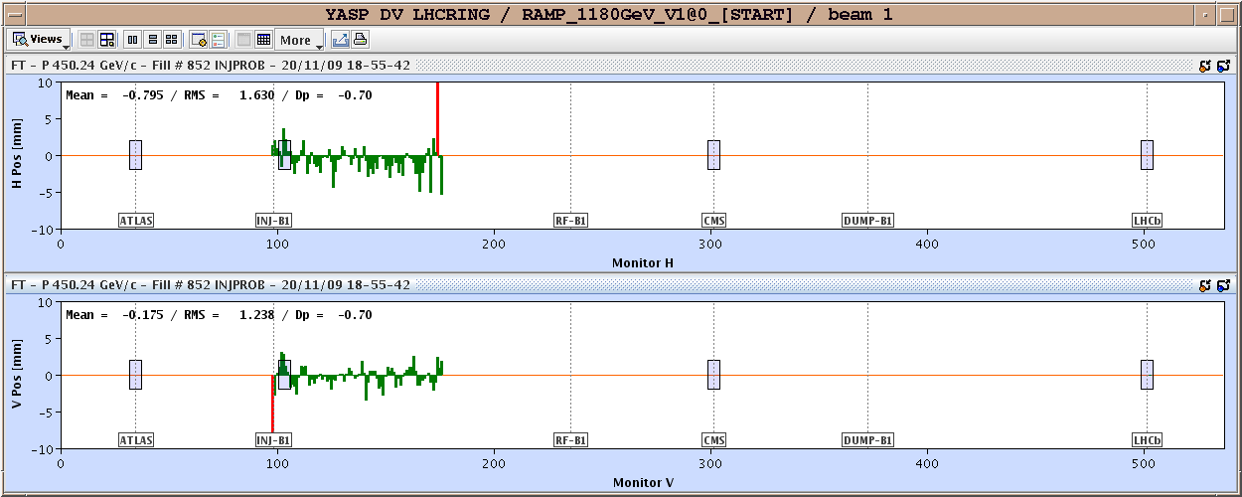
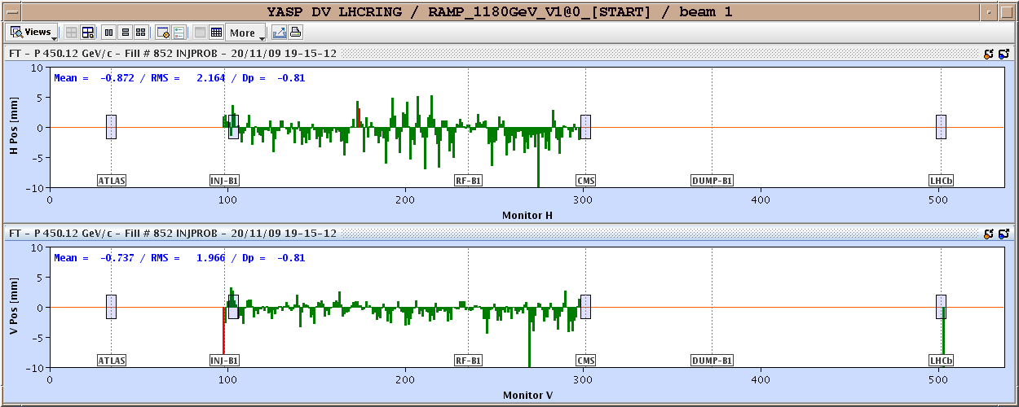
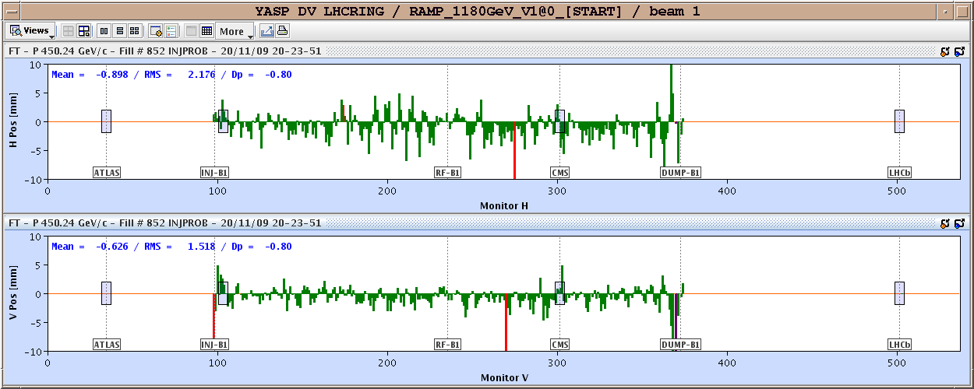
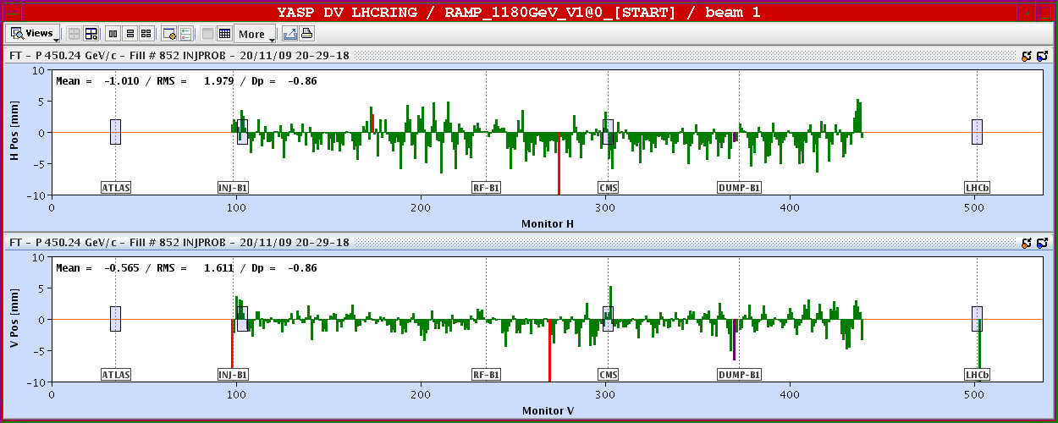
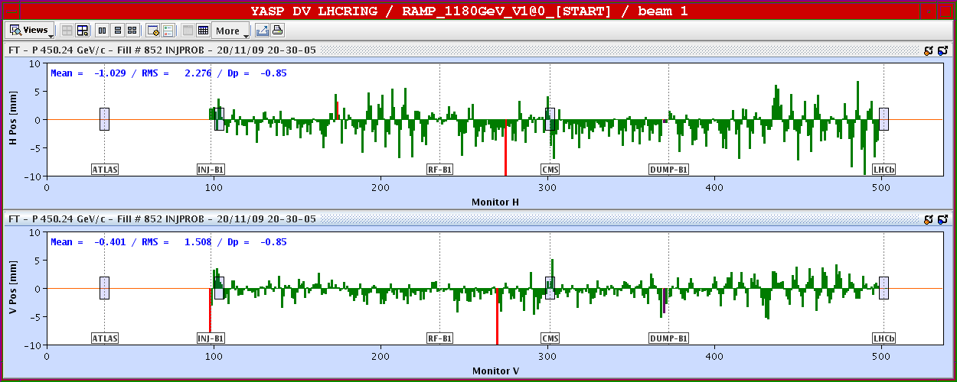
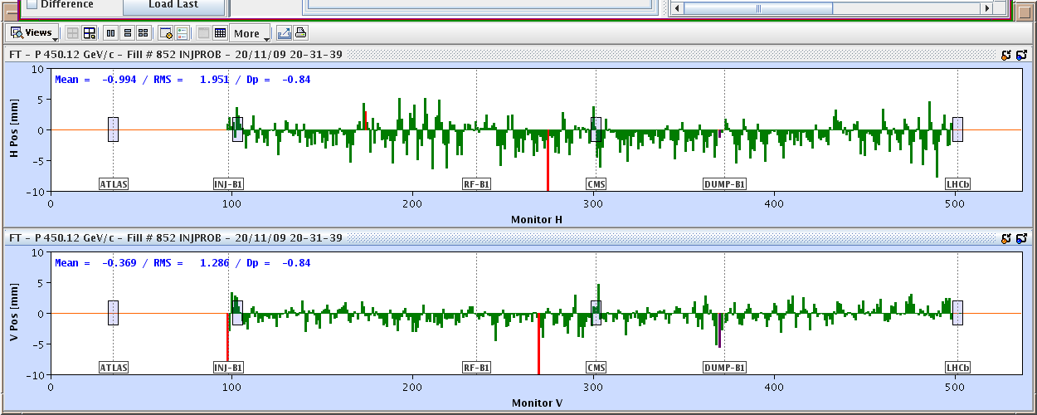
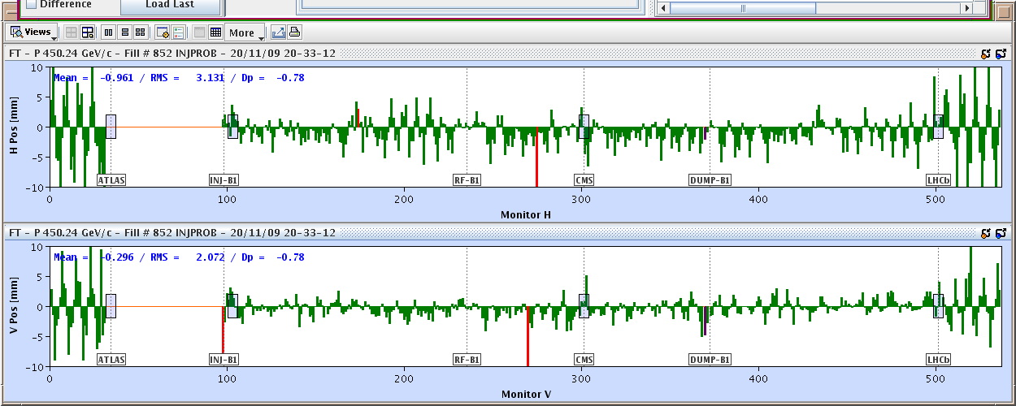
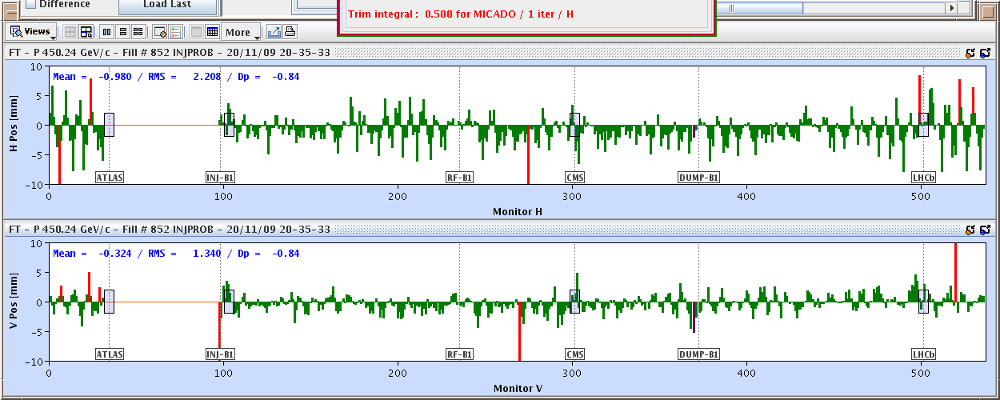
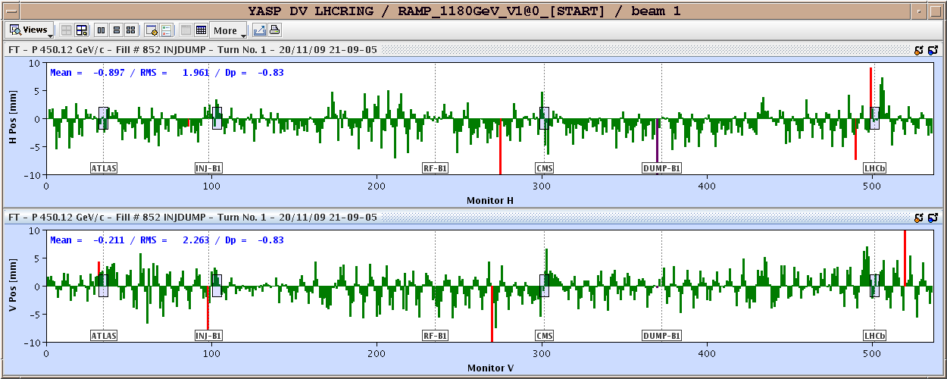
November 20, 2009: Going around…again
Total time: 1:43
Then things began to move with dizzying speed…

Slide 29
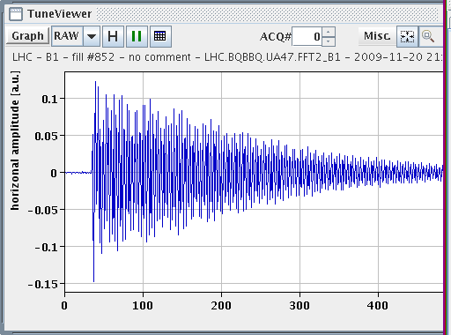
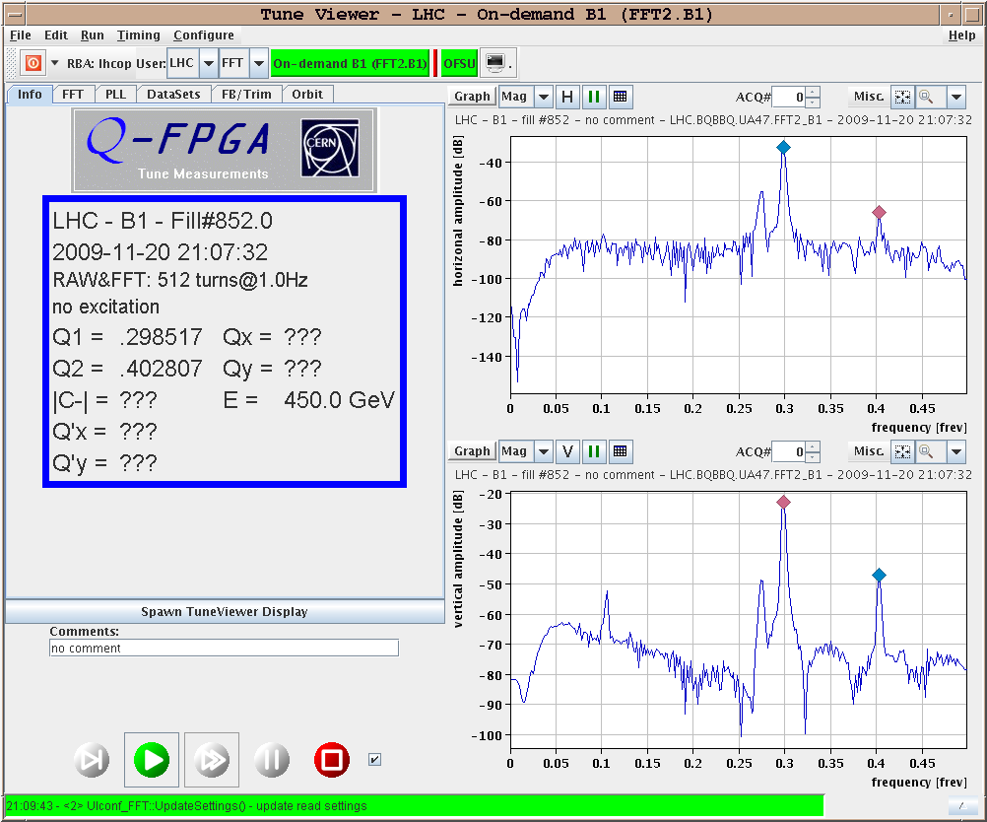
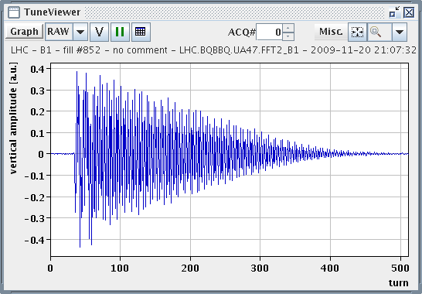
First Tune Measurement (within an hour)

Slide 30
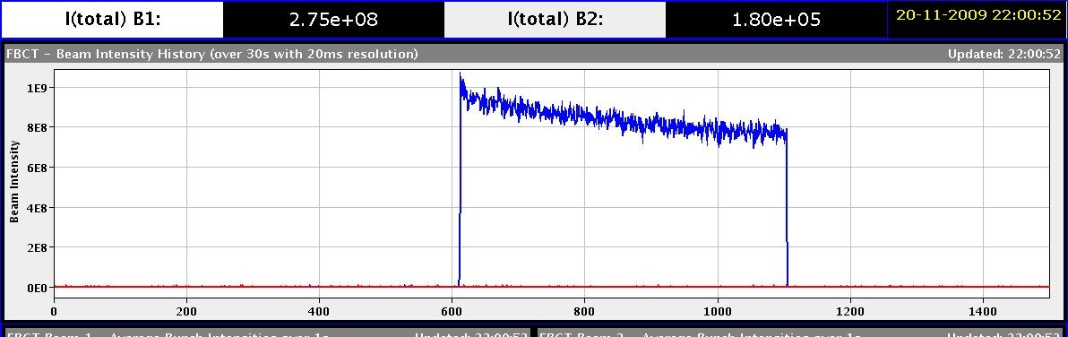
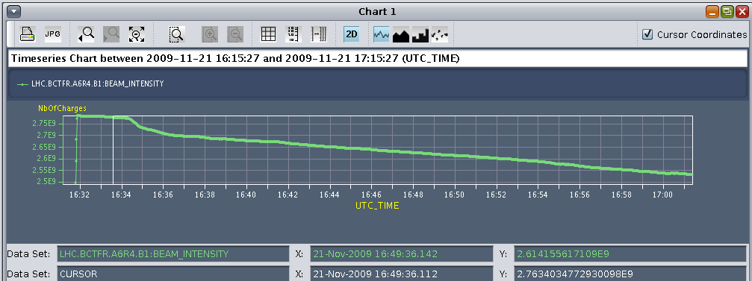
Beam 1 Captured about an hour after first turn!!

Slide 31
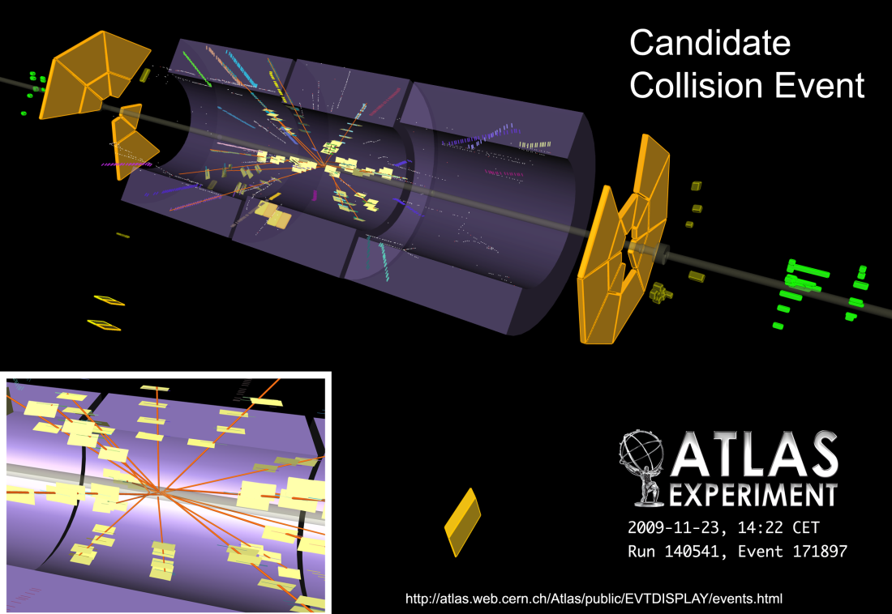
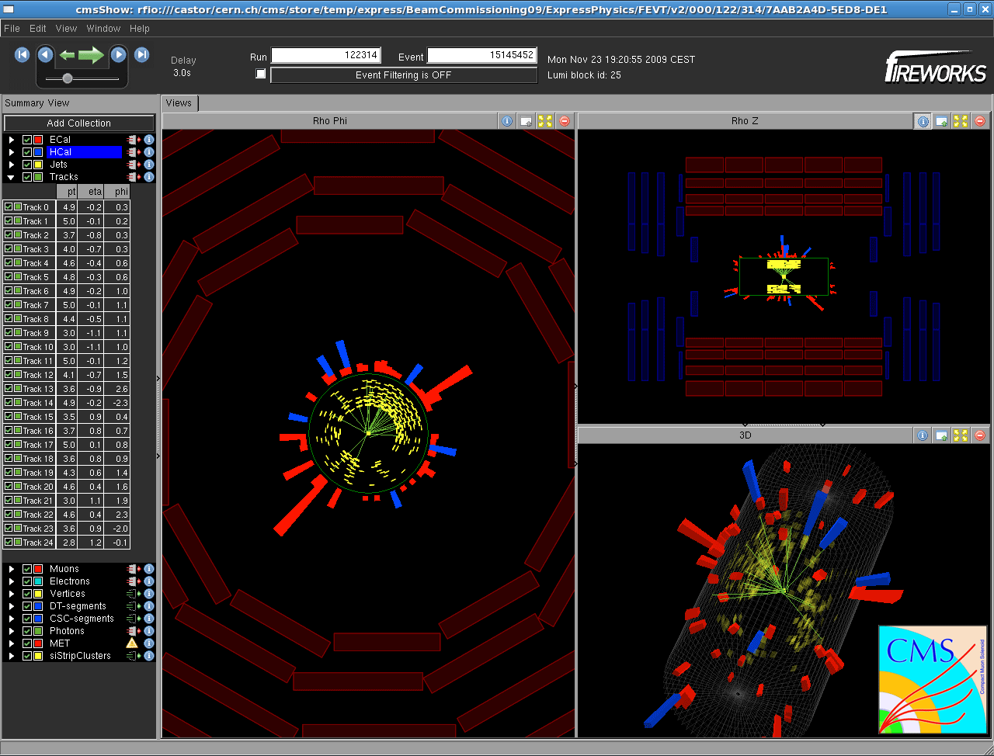
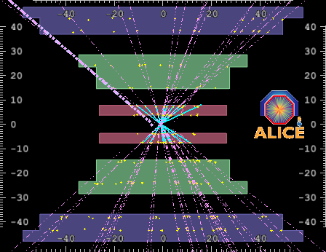
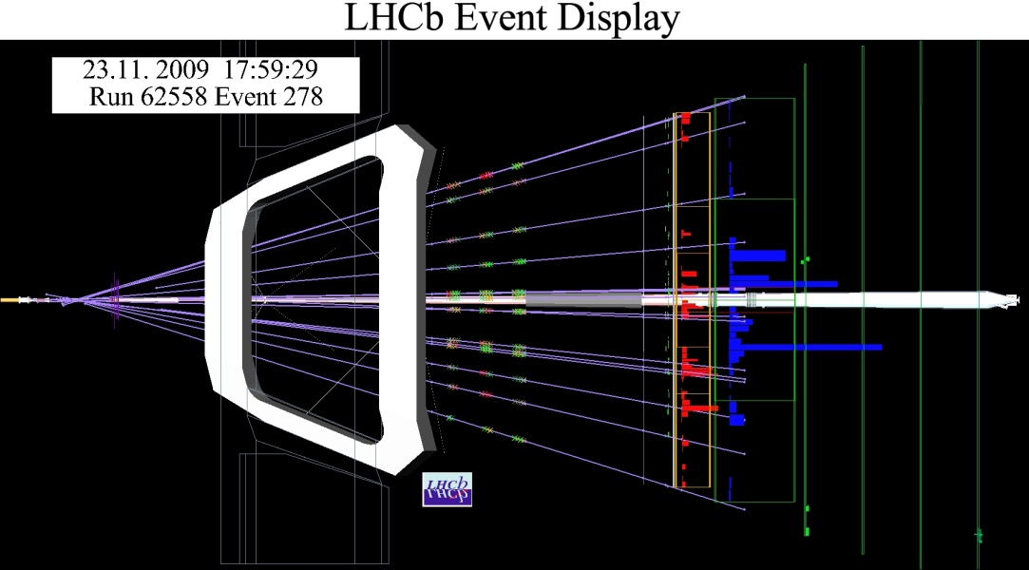
November 23rd: First Collisions!

Slide 32
Progress since start up
Sunday, November 29th
Both beams accelerated to 1.18 TeV simultaneously
Sunday, December 6th
Stable 4x4 collisions at 450 GeV
Tuesday, December 8th
2x2 accelerated to 1.18 TeV
First collisions seen in ATLAS before beam lost!
Monday, December 14th
Stable 2x2 at 1.18 TeV
Collisions in all four experiments
16x16 at 450 GeV
Wednesday, December 16th
4x4 to 1.18 TeV
Squeeze to 7m
Collisions in all four experiments
18:00 – 2009 run ended
>1 million events at 450x450 GeV
50,000 events at 1.18x1.18 TeV
Merry Christmas – shutdown until Feb. 2010 to commission quench protection
LHC Highest energy accelerator
LHC Highest energy collider
Should be good to 3.5 TeV after restart

Slide 33
Commissioning*: 450 GeV
RF
Excellent apart from some controls & procedural issues
Measurement and control of key beam parameters
Orbit, tune, chromaticity, coupling, dispersion
lifetime optimization: tune, chromaticity, orbit
energy matching
aperture
Optics checks
beating & correction
polarity checks of correctors and BPMs
*Courtesy Mike Lamont

Slide 34
Commissioning: Ramp and 1.18 TeV
Ramp
2 beams to 1.2 TeV
Feedback excellent, feed forward show good reproducibility
Squeeze
Some work required here but impressive nonetheless
Collisions
steering, scans
Two beam operation – with and without bumps
Experiments’ magnets
Solenoids – brought on without fuss and corrected
Dipoles – brought on at 450 GeV – issues with transfer functions

Slide 35
Commissioning (cont’d)
Beam dump
extensive program of tests with beam
Inject & dump, circulate & dump
Beam based alignment of TCDQ and TCS
Aperture scans
Extraction tests
Synchronization with abort gap
Asynchronous beam dump tests with de-bunched beam
Collimation
Full program of beam based positioning,
hierarchy established and respected in tests
collimation setup remained valid over 6 days, relying on orbit reproducibility and optics stability
Even the Roman pots got a run out

Slide 36
Commissioning (cont’d)
Beam Position Monitors (BPM’s)
looking very good, FIFO as per injection tests
capture mode commissioned – enabling multi-turn acquisition and analysis
Beam Loss Monitors (BLM’s)
magnificent following full deployment during injection tests – a close to full operational tool
issues with SEMs, some thresholds to be adjusted, some still masked
Beam Current Measurement (DBCT, FBCT, lifetime)
commissioned and operational
controls issues
Wire scanners
operational, calibrated and giving reasonable numbers
Coupling
measured and corrected
Abort Gap Monitor
cleaning attempted with transverse damper

Slide 37
Commissioning (cont’d)
Tune
BBQ FFT from day 1 – used in feedback during ramp
horizontal and vertical MKQA tune kicker for B1 and B2 operational
PLL – good progress, feedback to be tested
radial modulation tested
issues with the hump, tune stability, 8 kHz
Chromaticity
Standard method
Semi-automatic BBQ peak analysis
Radial modulation
Synchrotron light monitor
B2: undulator commissioned, SLM operational at 450 GeV and 1.2 TeV
B1: undulator not commissioned, SLM operational at 1.2

Slide 38
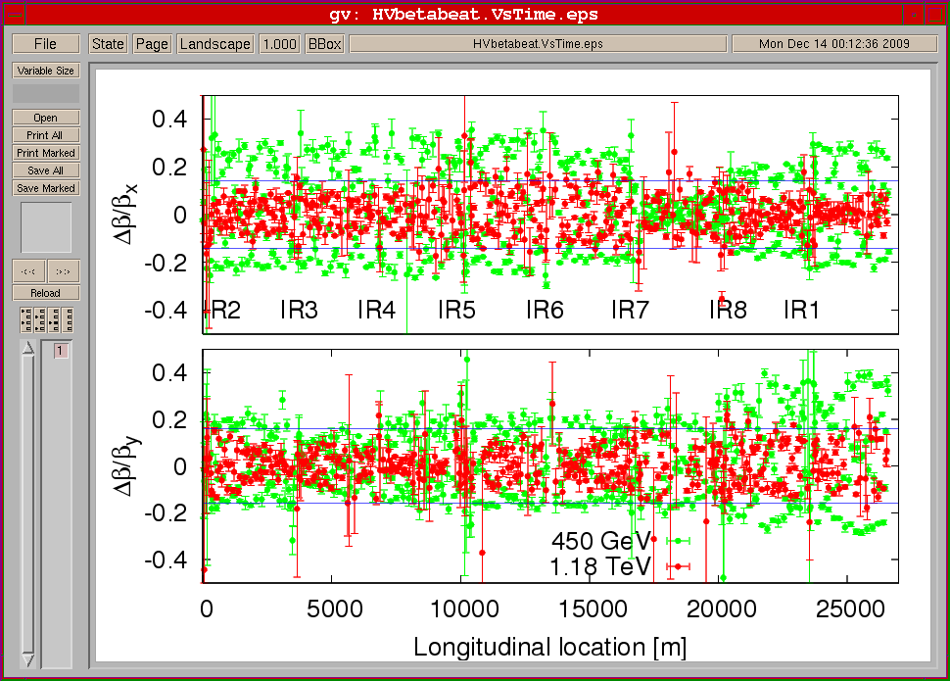
Optics measurements: 450 GeV and 1.18 TeV
LHC Beam
Commissioning
Team
Commissioning slides from talk by R. Assmann and F. Schmidt at recent Tevatron studies workshop

Slide 39
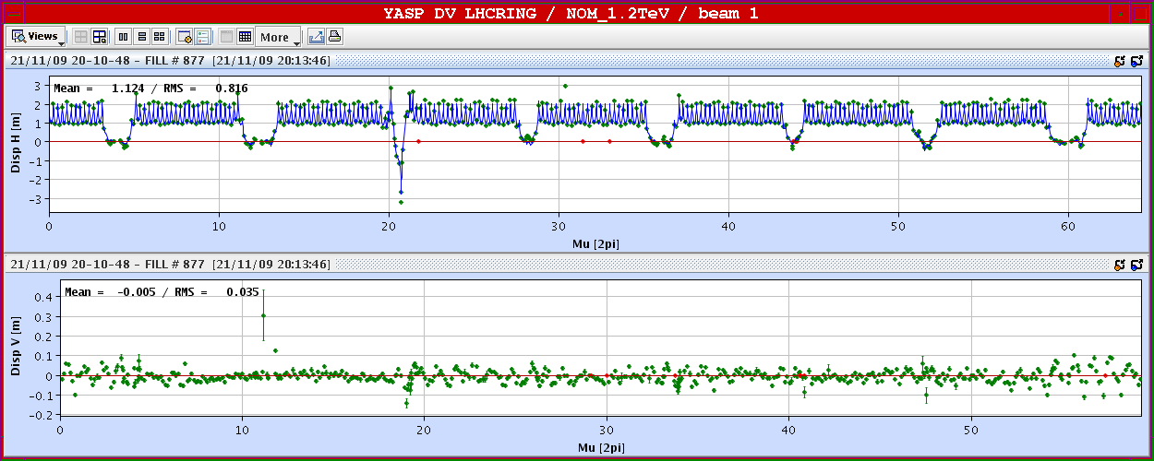
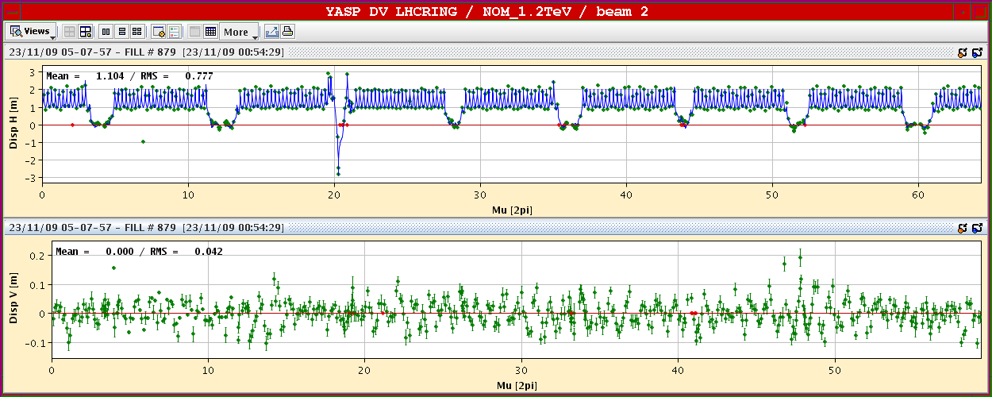
Dispersion

Slide 40
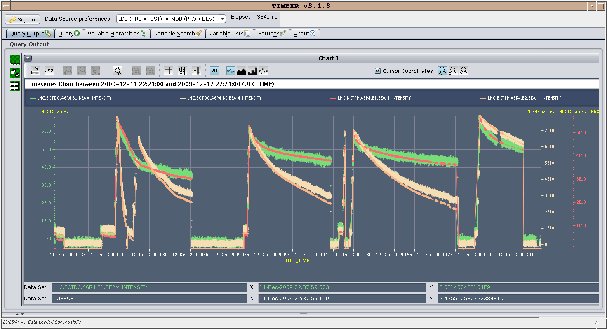
Dec. 13, 2009: 24 hours running - currents

Slide 41

CMS Aperture (vertical)

Slide 42

Beam Dump with 16 Bunches
Kickers sweep bunches to “dilute” intensity on dump

Slide 43

LHC Collimation Performance (Phase I System)
Could get to design intensity (at injection energy)

Slide 44

Ramp 2 on 2 to 1.18 TeV: ~no Losses

Slide 45



Tunes and Tune Control Loop

Slide 46


Tune Adjustments for Beam2
B1: Q_{x} = 0.293, Q_{y} = 0.269; lifetime = 26h B2: Q_{x} = 0.297, Q_{y} = 0.267; lifetime = 5h
B1: Q_{x} = 0.293, Q_{y} = 0.269; lifetime = 25h B2: Q_{x} = 0.312, Q_{y} = 0.305; lifetime = 12h
1/3
3/10
3/11
2/7
LHC Beam
Commissioning
Team

Slide 47

Beam size measurements (blow up on beam 2)

Slide 48


Beam Control at 1.18 TeV
Position control
Tune feedback
Bump introduced
Removed by feedback loop
Feel happy that yellow line and pink line add up to blue line
Automated feedbacks seem to be working, but not quite yet standard operations.
Bottom line: things look good!

Slide 49

General Plan for 2010*
1 month pilot & commissioning
3 month 3.5 TeV
1 month to go up in energy (maybe)
5 month 5 TeV
1 month ions
Decision whether to go above 3.5 TeV will be made next week at Chamonix
Based on “confidence in thermal model”
50/50 according to Mike Lamont

Slide 50
Understanding LHC Luminosity
Total beam current. Limited by:
Uncontrolled beam loss!!
E-cloud and other instabilities
Brightness, limited by
Injector chain
Max tune-shift
If n_{b}>156, must turn on crossing angle
β*, limited by
magnet technology
chromatic effects
Geometric factor, related to crossing angle…
*see, eg, F. Zimmermann, “CERN Upgrade Plans”, EPS-HEP 09, Krakow, for a thorough discussion of luminosity factors.

Slide 51

Maybe. Otherwise, push luminosity at 3.5 TeV

Slide 52

Collimation Limits to Luminosity

Slide 53
Target Performance in 2010
Comment | Energy (TeV) | Max Bunches |  | Protons/ bunch | % nom. Intensity | Min. β* (m) | Peak Lum. (cm-²s⁻¹) | Int. Lum. (pb⁻¹)
Pilot Physics, Partial Squeeze, Gentle increase in bunch int. | 3.5 | 43 |  | 3x10¹⁰ |  | 4 | 8.6x10²⁹ | .1-.2
 | 3.5 | 43 |  | 5x10¹⁰ |  | 4 | 2.4x10³⁰ | ~1
Max. bunches with no angle | 3.5 | 156 |  | 5x10¹⁰ | 2.5 | 2 | 1.7x10³¹ | ~9
Push bunch intensity | 3.5 | 156 |  | 7x10¹⁰ | 3.4 | 2 | 3.4x10³¹ | ~18
 | 3.5 | 156 |  | 10x10¹⁰ | 4.8 | 2 | 6.9x10³¹ | ~36
Increase energy to 4-5 TeV, as deemed prudent | Would aim to first provide a period of physics at the higher energy without crossing angle, this could be followed by a move to 50 ns with a limited number of bunches.
 | 4-5 |  | 156 | 7x10¹⁰ | 3.4 | 2 | 4.9x10³¹ | ~26
Introduce 50 ns bunch trains and crossing angle! | 4-5 |  | 144 | 7x10¹⁰ | 3.1 | 2 | 4.4x10³¹ | ~23
Push n_{b} and N_{b} to limit of machine safety. | 4-5 |  | 288 | 7x10¹⁰ | 6.2 | 2 | 8.8x10³¹ | ~46
 | 4-5 |  | 432 | 7x10¹⁰ | 9.4 | 2 | 1.3x10³² | ~69
 | 4-5 |  | 432 | 9x10¹⁰ | 11.5* | 2 | 2.1x10³² | ~110
*limited by collimation system

Slide 54

Beyond 10³²
Going beyond a few percent of the design luminosity depends on how far they are willing to push the existing collimation system.
Won’t really know about this until after significant running experience
Getting anywhere near 10³⁴ requires the Phase II collimation system
Details and schedule still being worked out
Expect some guidance from Chamonix
Projection assuming Phase II collimation and Phase I upgrade done in 2013/2014 shutdown*
*R. Assmann, “Cassandra Talk”

Slide 55

Getting to 7 TeV*
Note, at high field, max 2-3 quenches/day/sector
Sectors can be done in parallel/day/sector (can be done in parallel)
No decision yet, but it will be a while
*my summary of data from A. Verveij, talk at Chamonix, Jan. 2009

Slide 56
LHC Upgrade path
Initial operation
Ramp up to 1x10³⁴ cm⁻²s⁻¹
Phase I upgrade
After ~2 years of operation (~2014)
Replace 70 mm triplet quads with 120 mm quads
β* goes from 50->30 cm
Linac4 to increase PSB injection energy to reduce space charge effects
Luminosity goes to 2-3x10³⁴ cm⁻²s⁻¹
Phase II upgrade
Second half of next decade (nominally 2020)
Luminosity goal: 1x10³⁵
Details still under study
New technology for larger aperture quads (Nb₃Sn)
crab cavities?
Improved injector chain (PS2 + SPL)?
No major changes to optics or IR’s
Possible Significant Changes

Slide 57
Acknowledgements and further reading
This talk represents the work of an almost countless number of people.
I have incorporated significant material from:
Numerous talks given at the 2009 Chamonix session regarding “The Incident”
http://tinyurl.com/Chamonix2009
Mirko Pojer’s talk at the US LHC Users’ Organization meeting at LBNL in September, 2009
http://tinyurl.com/usluo2009-pojer
Oliver Bruening’s talks at the LARP collaboration meeting in November
http://tinyurl.com/cm13-bruening1
http://tinyurl.com/cm13-bruening2 (taken from Roger Bailey)
Commissioning status slides from Mike Lamont, and also significant material shown by Ralph Assmann and Frank Schmidt at the recent Tevatron Studies Workshop
http://tinyurl.com/Tev-studies-workshop-2010
Luminosity considerations and upgrade plans, Frank Zimmermann’s talk to EPS-HEP, Krakow 2009
http://tinyurl.com/Zimmermann-Krakow
All things collimation (in particular, R. Assmann “Cassandra Talk”)
http://lhc-collimation-project.web.cern.ch/

Slide 58
Staying informed
Twitter feed (big news):
http://twitter.com/cern
Commissioning log (more technical detail):
http://tinyurl.com/LHC-commissioning
E-logbook (very technical, but good plots):
http://elogbook.cern.ch/eLogbook/eLogbook.jsp?lgbk=60
Only visible inside CERN network (if you have a CERN account, you can use remote desktop or VPN from US).

Slide 59
Backup slides

Slide 60
Decisions Q1 2009
Sector 34 repair
Restart
Q4 2008 | Q1 2009 | Q2 2009 | Q3 2009 | Q4 2009
Based on discussions at Chamonix 2009
Decided to warm up in 12 and 67 to replace faulty magnets
Decided to warm up sector 56 in parallel for other reasons
Q4 2008 |  | Q1 2009
12 | Cold | Cold ➔ Warm
23 | < 100K | < 100K
34 | Warm | Warm
45 | < 100K | < 100K
56 | Cold | Cold ➔ Warm
67 | Cold | Cold ➔ Warm
78 | Cold | < 100K
81 | Cold | < 100K
Warming up means
3 weeks to get to 300K
Repair work
ELQA and other issues
6 weeks to get back to 2K
Talk by O. Bruning, LARP CM13 meeting, November, 2009

Slide 61

Longitudinal displacements in damaged area
J.Ph. Tock

Slide 62


Machine wide investigations Q2 2009
Electrical measurements while warm on sectors 12 34 56 67
Confirms new problem with the copper stabilizers
Non-invasive electrical measurements to show suspicious regions
Several bad regions found
Open and make precise local electrical measurements
Several bad stabilizers found (30µΩ to 50µΩ) and fixed
Measured other 4 sectors at 80K (noisy but gives limits)

Slide 63
LHC Parameters and Options*
Parameter | Symbol | Initial | Phase I | Phase II Options
 |  |  |  | Early Sep. | Full Crab | Low Emit. | Large Piw. Ang.
transverse emittance | ε [μm] | 3.75 | 3.75 | 3.75 | 3.75 | 1.0 | 3.75
protons per bunch | N_{b} [10¹¹] | 1.15 | 1.7 | 1.7 | 1.7 | 1.7 | 4.9
bunch spacing | Δt [ns] | 25 | 25 | 25 | 25 | 25 | 50
beam current | I [A] | 0.58 | 0.86 | 0.86 | 0.86 | 0.86 | 1.22
longitudinal profile |  | Gauss | Gauss | Gauss | Gauss | Gauss | Flat
rms bunch length | σ_{z} [cm] | 7.55 | 7.55 | 7.55 | 7.55 | 7.55 | 11.8
beta* at IP1&5 | β∗ [m] | 0.55 | 0.3 | 0.08 | 0.08 | 0.1 | 0.25
full crossing angle | θ_{c} [μrad] | 285 | 410 | 0 | 0 | 311 | 381
Piwinski parameter | φ=θ_{c}σ_{z}/(2*σ_{x}*) | 0.64 | 1.26 | 0 | 0 | 3.2 | 2.0
peak luminosity | L [10³⁴ cm⁻²s⁻¹] | 1 | 3.0 | 14.0 | 14.0 | 16.3 | 11.9
peak events/crossing |  | 19 | 57 | 266 | 266 | 310 | 452
initial lumi lifetime | τ_{L} [h] | 22 | 11 | 2.2 | 2.2 | 2.0 | 4.0
Luminous region | σ_{l} [cm] | 4.5 | 3.3 | 5.3 | 5.3 | 1.6 | 4.2
*excerpted from F. Zimmermann, “LHC Upgrades”, EPS-HEP 09, Krakow, July 2009

Slide 64

Limits of Phase I Collimation System*
Collimation at tightest settings throughout ramp and squeeze
Somewhat more relaxed collimation settings
*Ralph Assmann, “Cassandra Talk”

